Slide 1
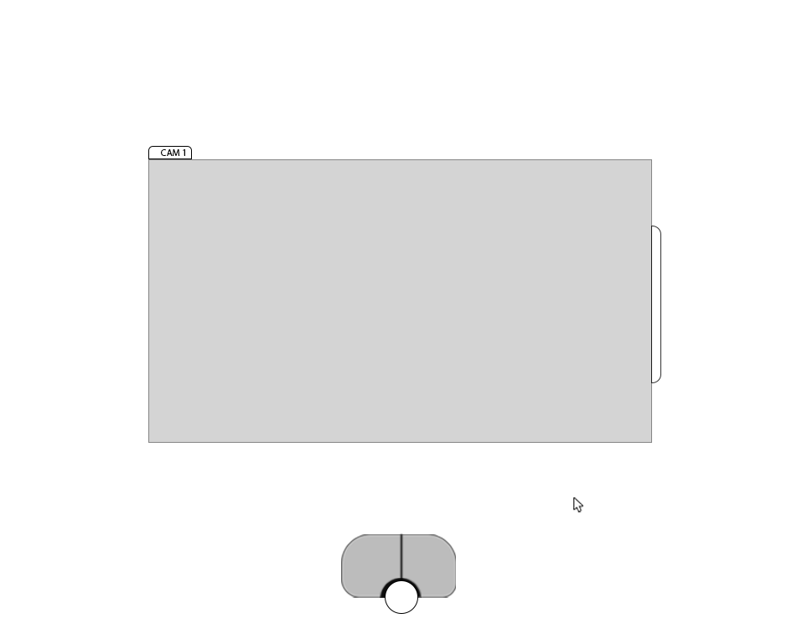
After Splash screen: Default Configuration of Surgeon View
Available actions (5):
Take a Snapshot (left pedal)
Start a recording (right pedal)
Pull up the surgery phase carousel (middle pedal click)
Open control menu (e.g. function menu, settings menu, settings tab – drag cursor and hover using pad)
Exit/Power down (in the works)
We can ignore the Cam indicator tab.
The frame is a 1920 x 1080 projection space that is mapped to the projection space of the BT-40s based on available technical info and modified with a menu. The frame scale may need to be modified if the menu must be captured inside the projection space, instead of just generated next to it.
This distance I think is subject to vary in the implementation, but I would generally recommend a limit of no further than 15 degrees from the center of the main projection space.
This graphic should have labels and visual pedal input feedback. It would be smart to have the capability to toggle its visibility on or off. Need to determine how to do this with the pedal itself, otherwise will have to be a setting in the dashboard. Its default function when settings are closed is to take snapshots and start/end recordings.

Slide 2
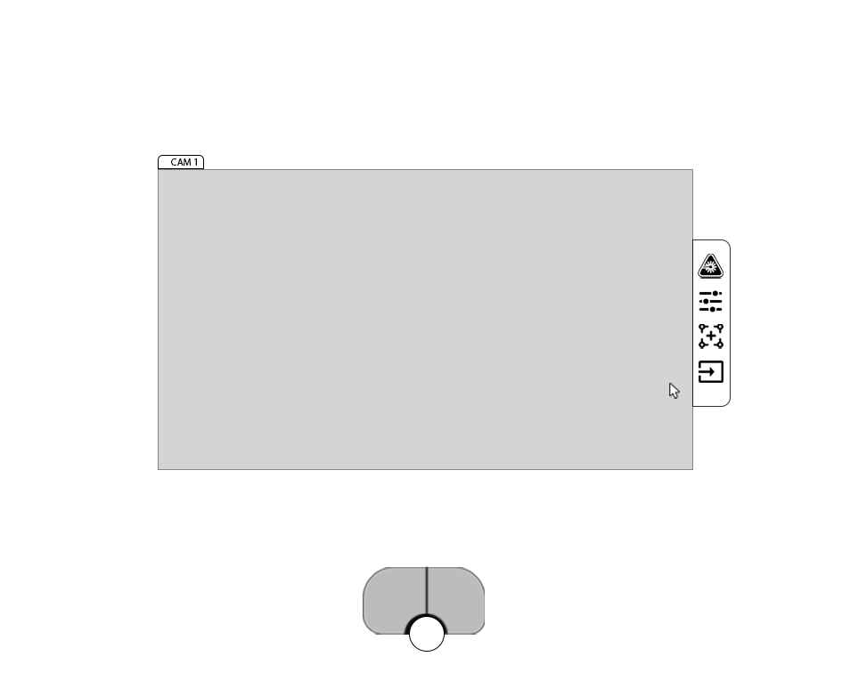
Surgeon view – Settings tab open (mouse hover)
Available actions (4):
Take a Snapshot (left pedal)
Start a recording (right pedal)
Pull up the surgery phase carousel (middle pedal click)
Exit/Power down (in the works)
- Move cursor over menu category icons (footpedal touchpad)
- Select a menu category (right pedal)
- Move cursor away from category icons (footpedal touchpad)
- Close menu independent of mouse (click middle)
Menu opens upon mouse hover. Available categories are, from the top: 1) Laser Toggle on/off,
2) Laser settings (considering bucketing it under laser toggle)
3) Alignment settings & calibration (potentially not needed due to beamsplitter)
4) Source and camera settings
Swipe
Not accessible while menu open

Slide 3
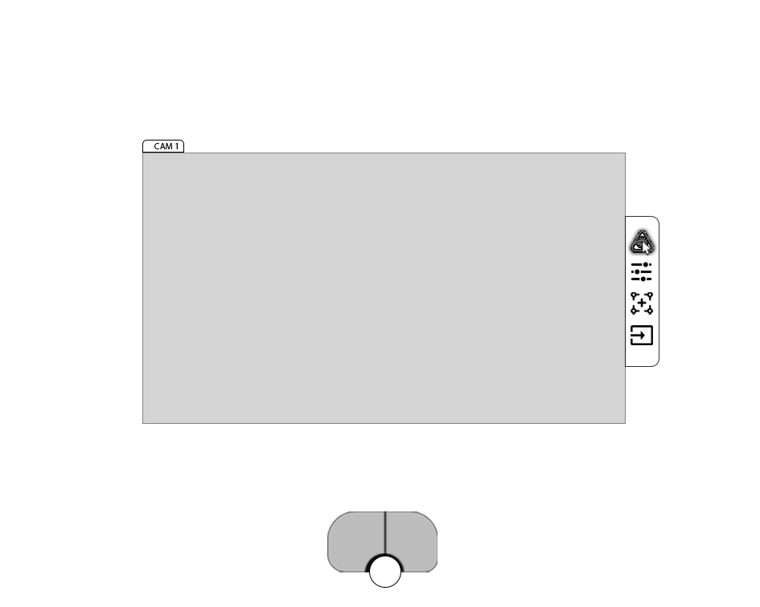
Surgeon view – Laser toggle on/off mouse hover
Available actions (4):
Turn the laser on or off (right pedal while hovering over icon)
Close menu (middle pedal)
Close menu (move cursor)
Open surgery phase carousel (double click middle pedal)
All Icons should eventually have floating tooltips, distinct visual states for hover or active, and a high contrast color scheme.

Slide 4
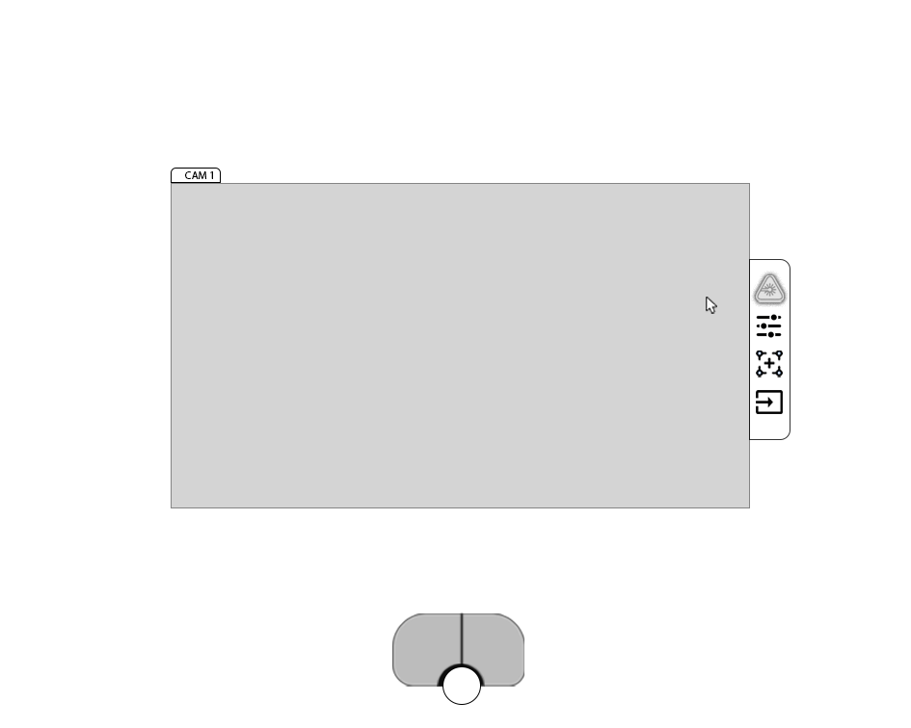
Surgeon view – Laser active, menu open
Available actions (5):
Hover over laser icon (cursor)
Close menu (middle pedal)
Close menu (move cursor)
Open surgery phase carousel (double click middle pedal)
Deactivate laser (click icon)
Example of a “laser active” icon state. Note: This laser activation command is its own icon to facilitate multiple activations and deactivations over the course of a procedure, as this is captured as a necessary function in the outlined standard of care for photographing the vivisected specimens.

Slide 5
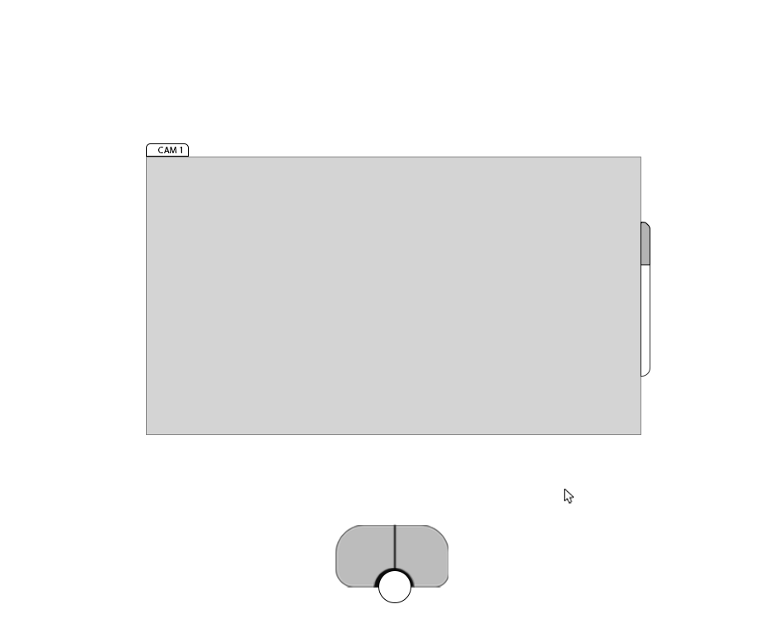
Surgeon view – Laser active, menu closed
Available actions (5):
Open menu (hover over menu with mouse)
Take a Snapshot (left pedal)
Start a recording (right pedal)
Pull up the surgery phase carousel (middle pedal click)
Exit/Power down (in the works)
Menu bar contains visual indicator of laser active state when closed, supporting the principle of visibility of system status. Should be high contrast, but not so salient as to become distracting. Muted shades of orange, green, or purple with a shaded border could work well here. We don’t really want red, because warnings or errors may be exclusively associated with red.

Slide 6
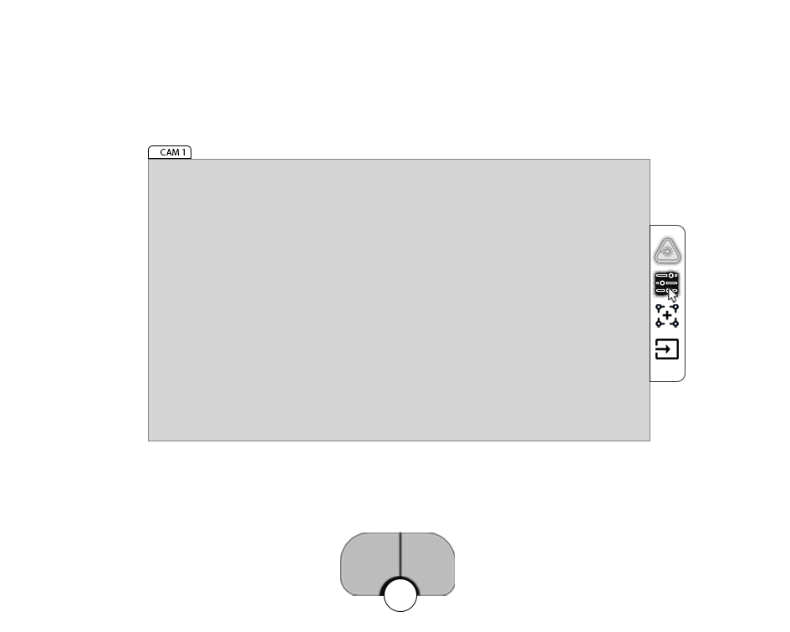
Surgeon view – menu open, lase settings hover

Slide 7
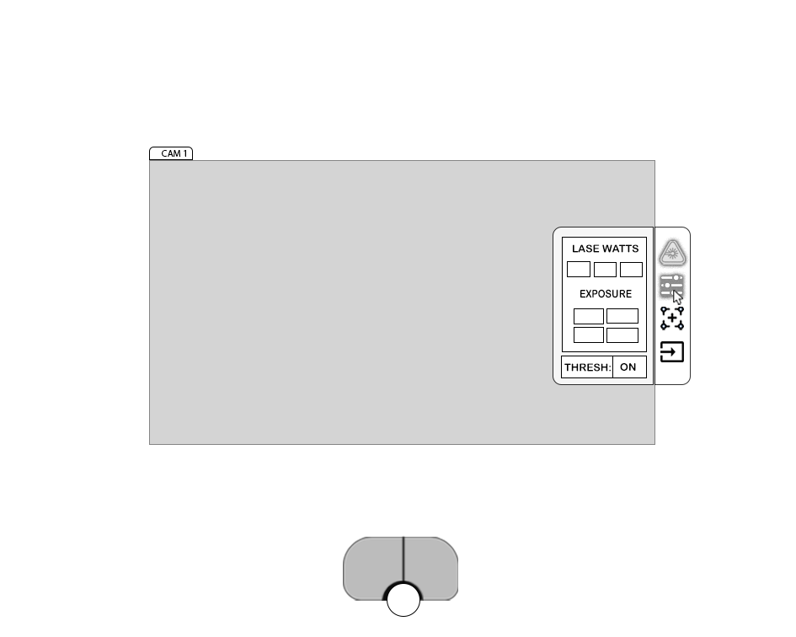
Surgeon view – menu open, laze settings menu
Available actions (2):
Change laser settings (move cursor and click)
Close the submenu (middle pedal) (click icon again)
Taking away the pedal’s camera functions with the menus open helps keep the design input-agnostic, as the left and right pedals can provide tabbing input. If we decide this isn’t necessary, perhaps it should be possible to change the laze settings with the menu open, and then take that snap or video without closing the menu.
In this mockup, I’ve specified that the sub-menu should be no wider than 1/5th of the projection frame.
The idea for the inlay sub-menus arises from the need to access only the broadest settings during the procedure that the surgeon can manage themselves. Bringing the settings closer to the working area of the visual field helps minimize the information access cost, but we need to assess whether this blocks the view too much through user testing.
Swipe Animation

Slide 8
Sub-menu collapses, swipe animation

Slide 9

Laser should still be active – ignore

Slide 10
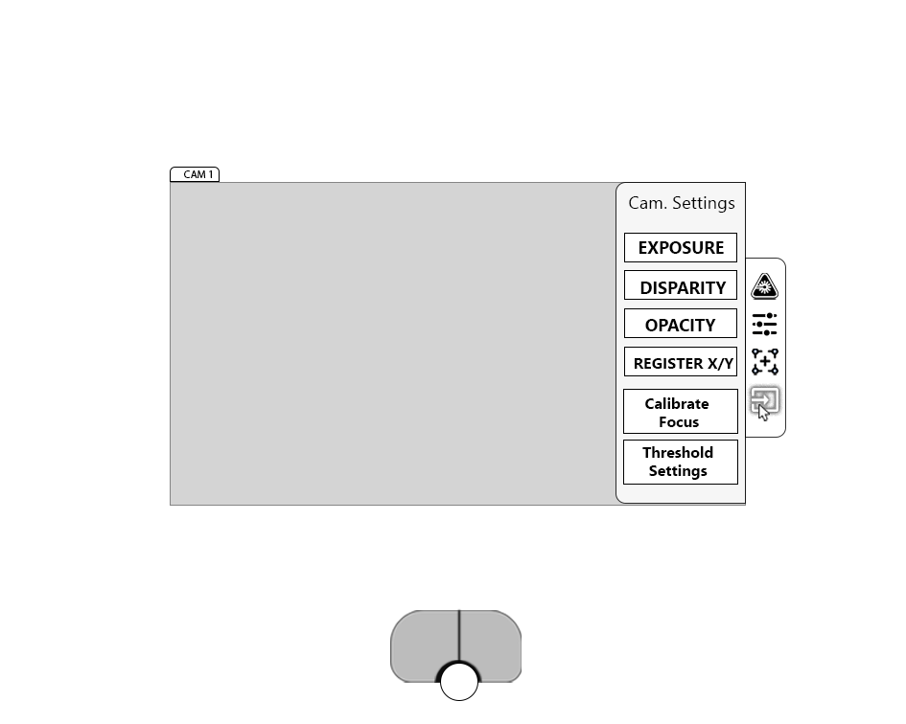
Surgeon view – Cam settings sub-menu open
Available actions (2):
Select a setting from the sub-menu (cursor)
Back out of the submenu (middle pedal, click icon again)
Same width limit here as the other menus.
This is a sub-menu that I thought could handle any parameter changes relevant to the input of either the IR camera or the visible light camera. Basically, our composite overlay settings independent from the laser settings. After reviewing, I will want to bring this down to only three (3) categories, so that the buttons may be larger, easier to navigate, and better targeted for the use cases.
Swipe Animation

Slide 11
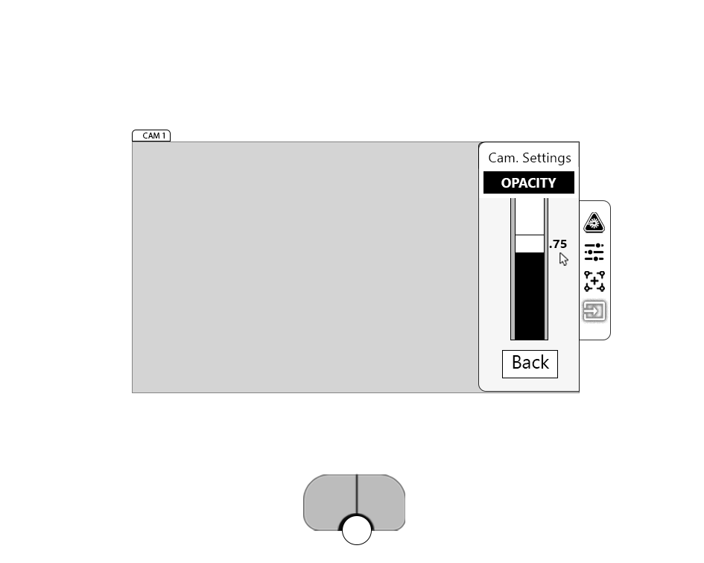
Slider-based parameter editing - For parameter classes that only have a single scale to edit, a single large, vertically arranged slider is the best way to enhance visibility while minimizing intrusion into the visual working space. The slider I’ve specified here contains five graphic elements for visibility:
1) An inclusionary (<) limit bar represented by the black, 2)an exclusionary(>) limit bar represented by the white,
3) A large, imprecise handle (center white)
4) Background 5) Callout with exact value
Surgeon view – Cam settings parameter open
Available actions (3):
Adjust value down (left on foot pedal)
Adjust value up (right on foot pedal)
Back out of parameter edit (back button with cursor)
OR
Select back button (middle pedal)
Confirm back (second click middle pedal)
Sub-menu title changes appearance and swipes up to the top, other content fades in
2
3
5
1
4
Swipe animation

Slide 12
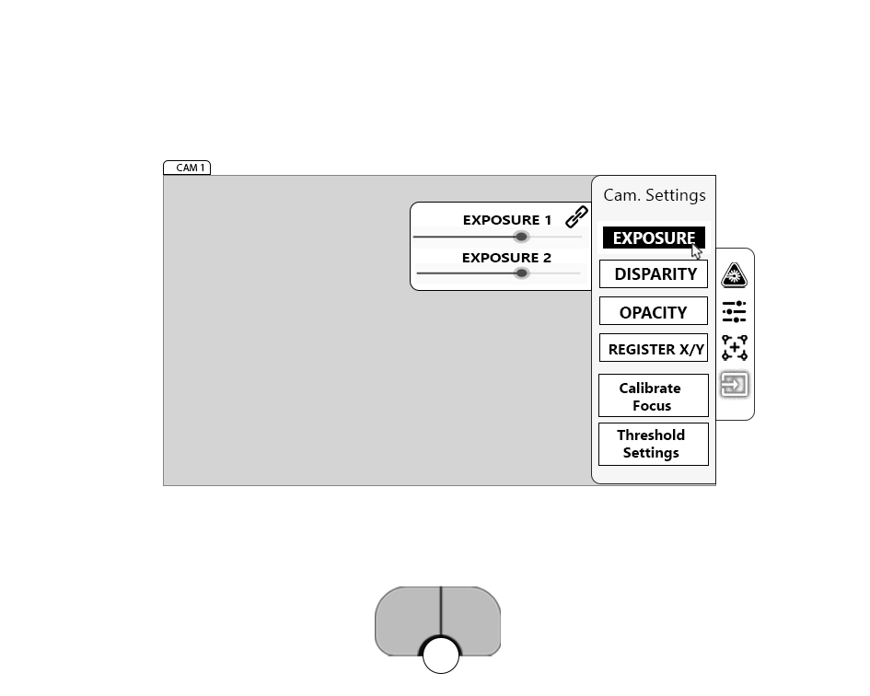
HIDDEN – OLD DESIGN, DO NOT USE

Slide 13
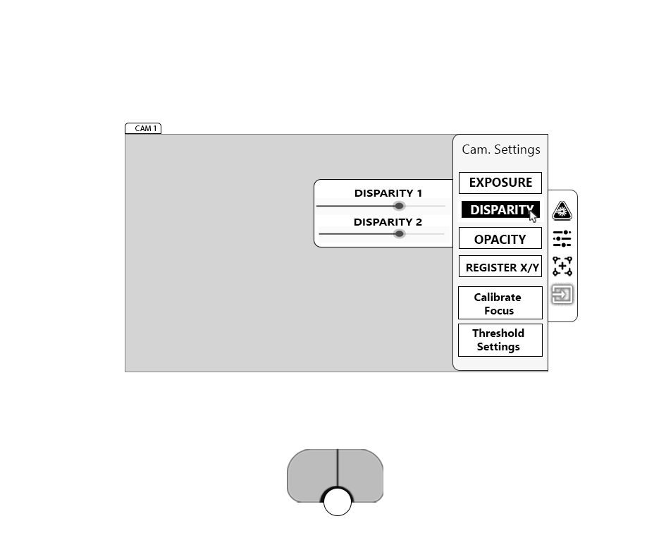
HIDDEN – OLD DESIGN, DO NOT USE

Slide 14
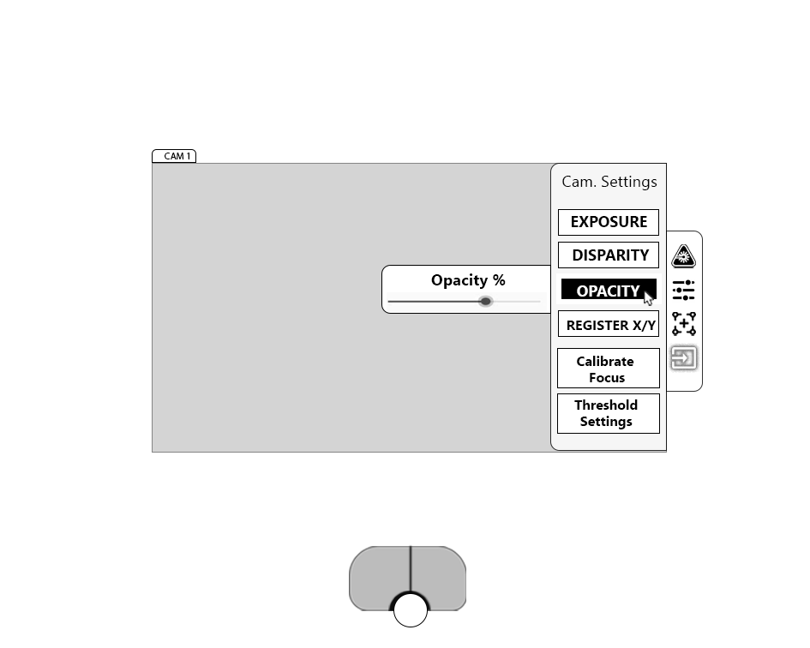
HIDDEN – OLD DESIGN, DO NOT USE

Slide 15
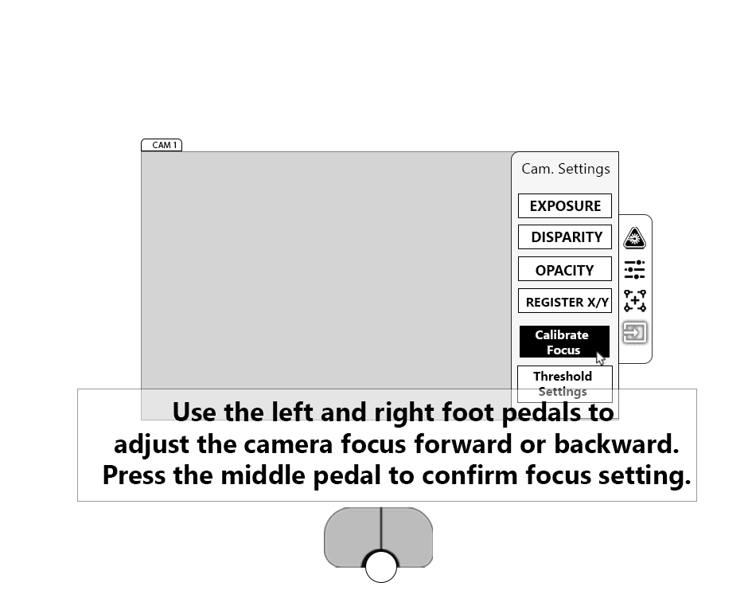
Surgeon view – Goal-oriented/Optimal adjustment editing, prompt
A prompt may be used to direct the surgeons’ input in a case where the context for adjustment is to reach a desired setting, or when the association between the pedal input and the parameter is not very clear.

Slide 16
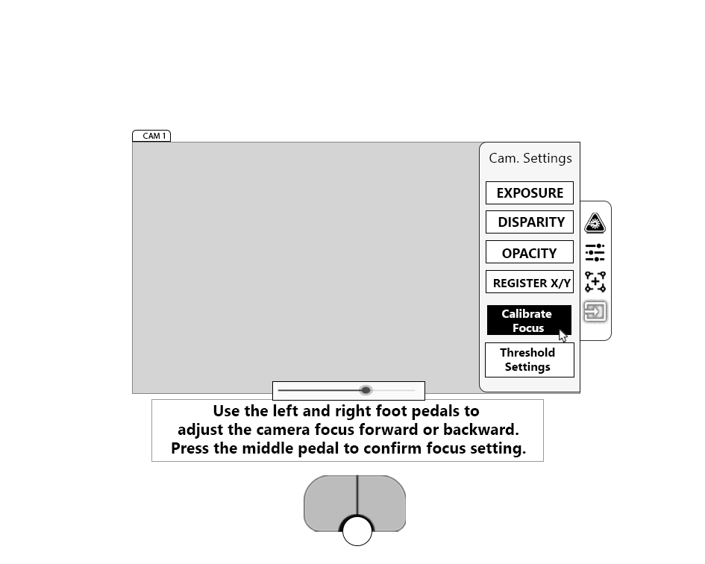
Surgeon view – Goal-oriented/Optimal adjustment editing, editing phase
Another concept for adjusting a single scale parameter in a submenu. This would be slower, as the instructions would present large for approximately 3 seconds and then recede to show the horizontally arranged slider. If we find we only need just a few of these continuous scale type parameters, this could be the primary way to go to minimize intrusion in the working visual field.

Slide 17
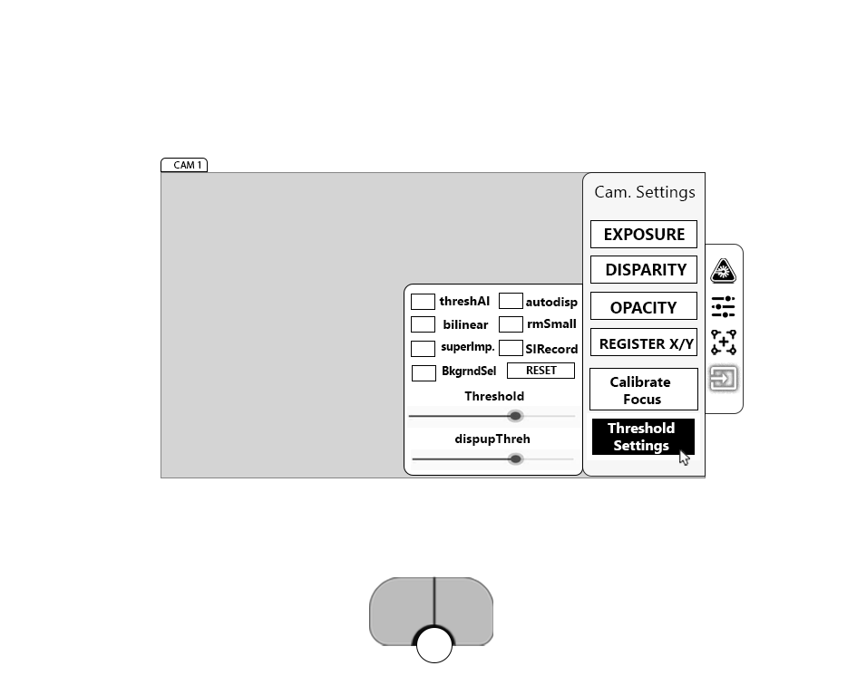
HIDDEN – OLD DESIGN, DO NOT USE

Slide 18
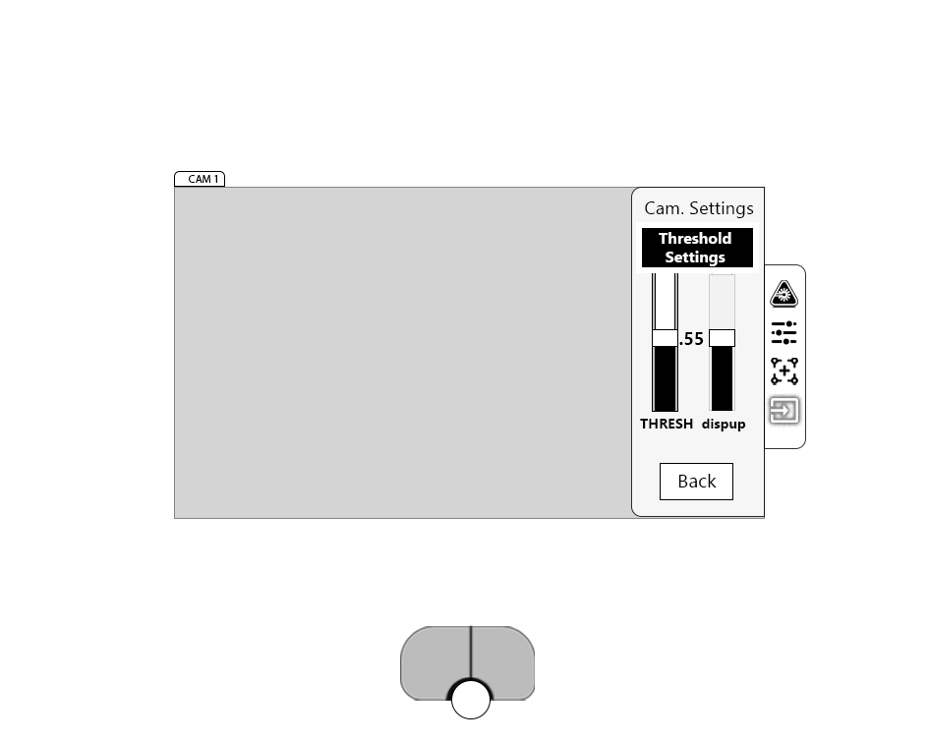
Surgeon view – Multiple continuous-scale parameters, editing
Available actions (5):
Cycle through active scales and back button (click middle pedal)
Close sub- menu (hold middle pedal)
Adjust slider up (right pedal)
Adjust slider down (left pedal)
When the back button is cycled to, right pedal to confirm close sub-menu.
The active slider bar should have the background element shown, while the inactive slider’s exclusionary space should be grayed out and flushed of contrast.
Opening a parameter category with more than one scale should present the user with the slider format presented earlier, except this time with labels at the bottom of each slider. They should be scaled to fit, but I’m thinking more than two parameters will be difficult to read and navigate easily.

Slide 19
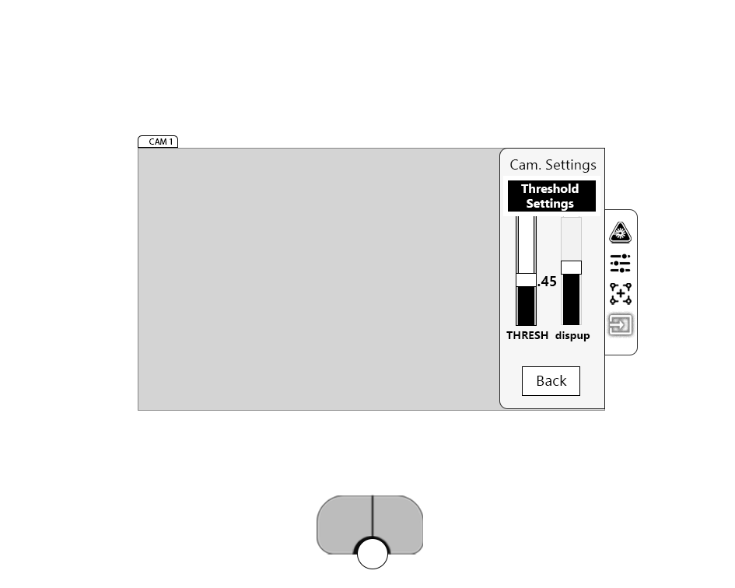

Slide 20
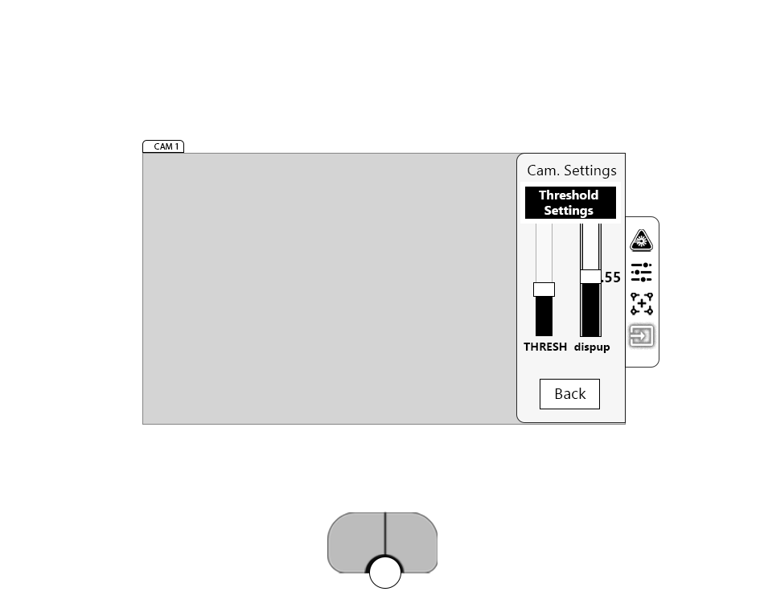

Slide 21
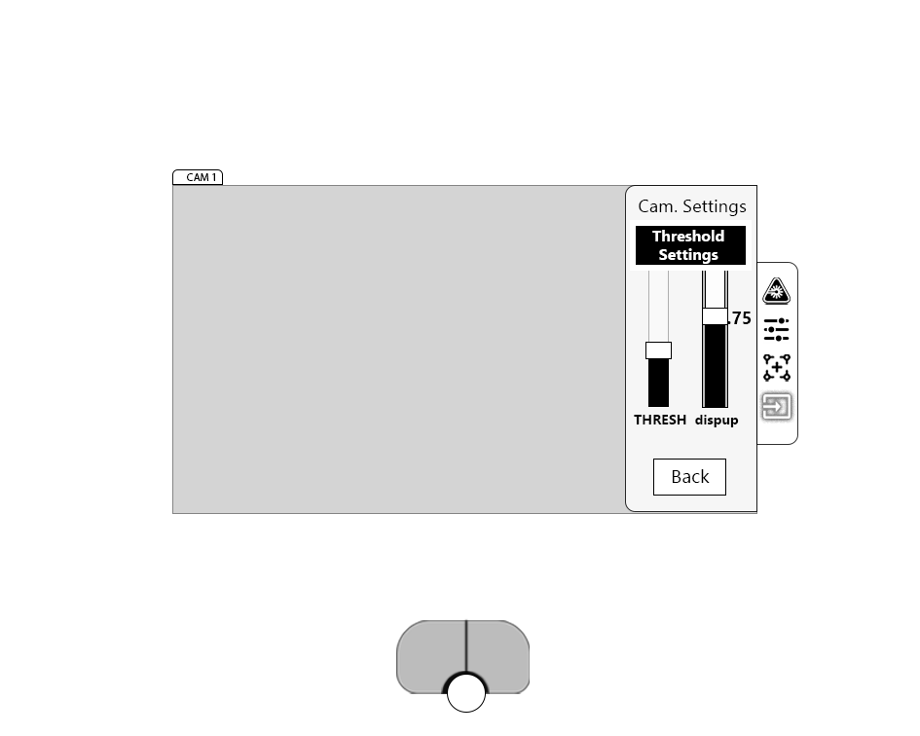

Slide 22
HOLDING

Slide 23
RELEASE

Slide 25
One more time to move all the way back to the beginning.

Slide 26
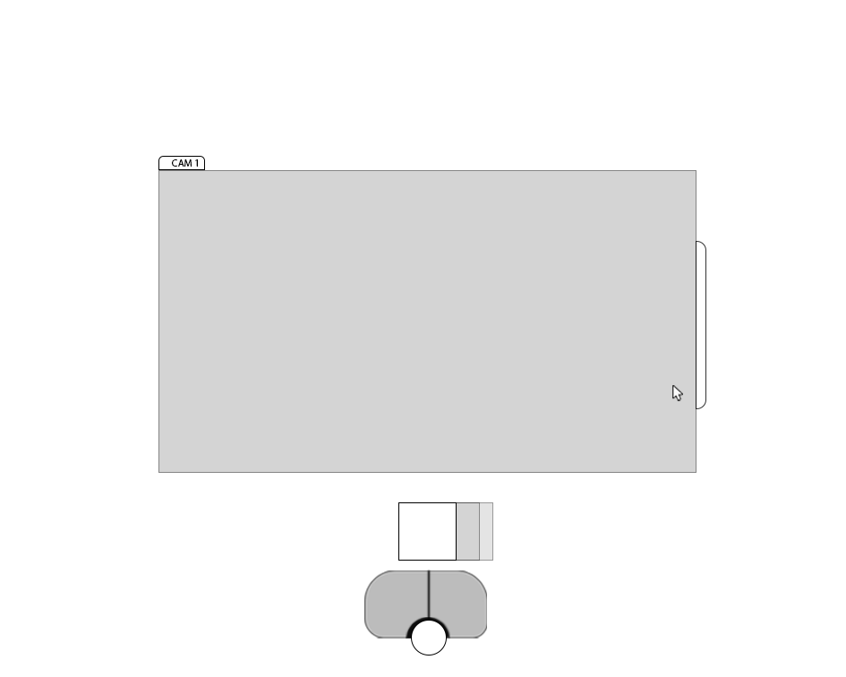
When the user is in this lowest-level static view, the pedal only controls the surgery phase selector and the snap/record functions. Middle pedal to bring the carousel up, right or left to navigate the predefined phases, and then right to select.
When thinking about the content that should represent the different surgery phases, we can include anything from abbreviated text to visual aids, but it should ultimately be the clearest and most salient representation to the surgeon.

Slide 27
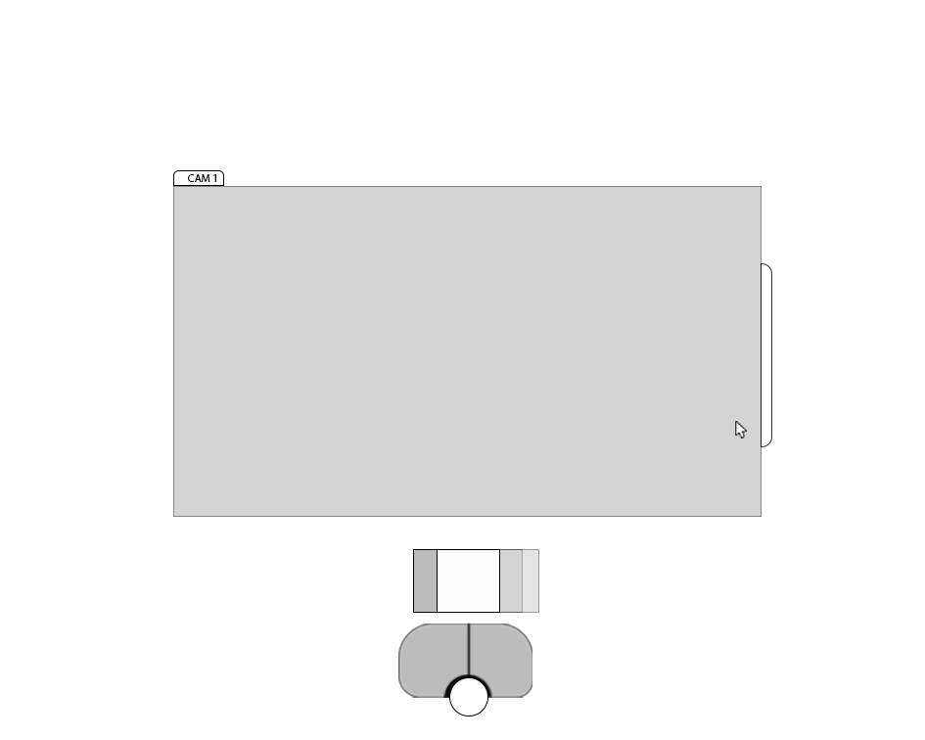

Slide 28
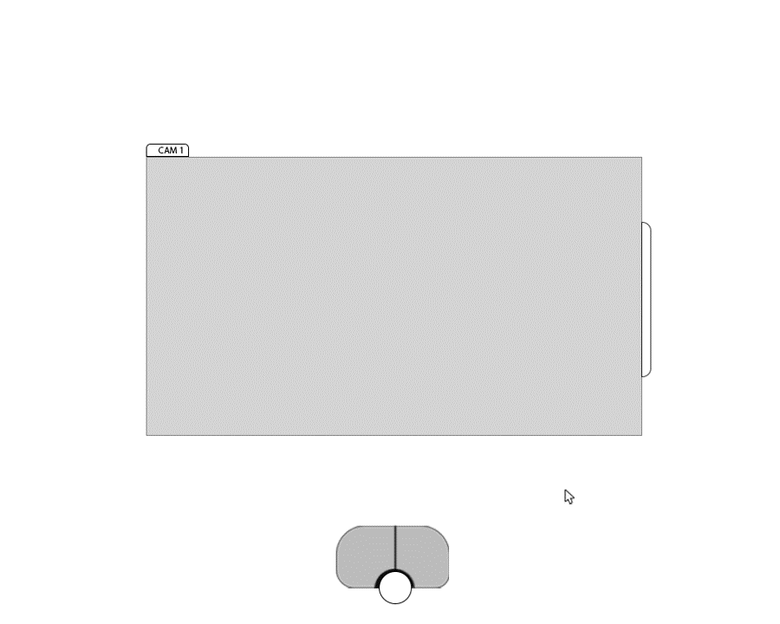

Slide 29
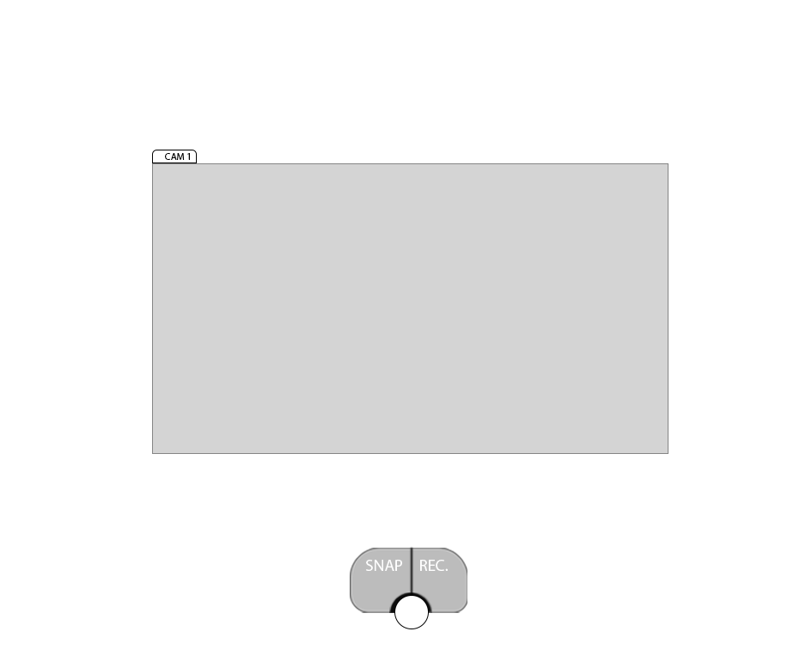
It would be nice to have labels on the controls in the little pedal widget that change dynamically based on which level of menu hierarchy the user is in.

Slide 30
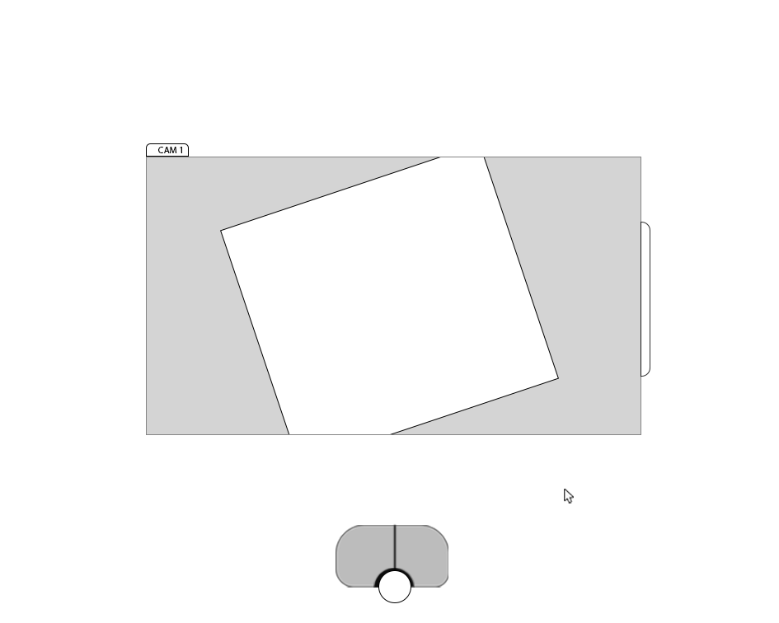

Slide 31
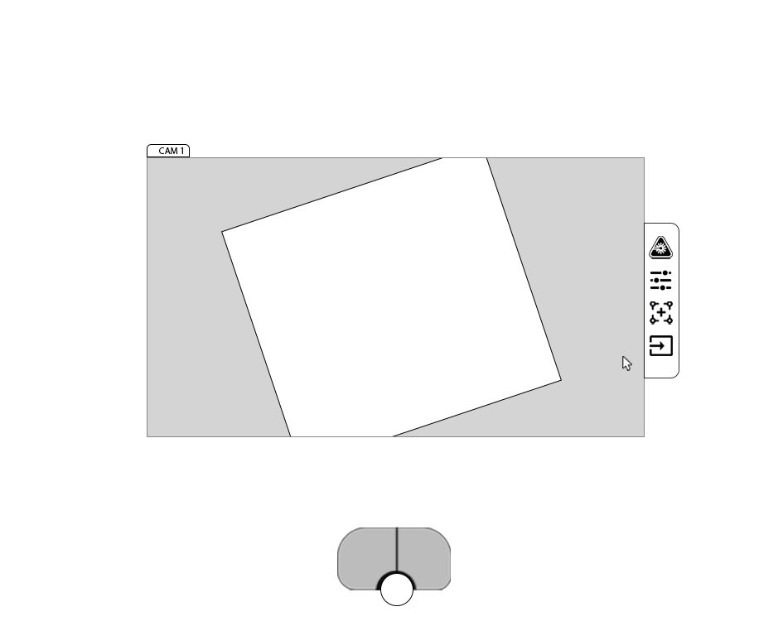

Slide 32


Slide 33


Slide 34
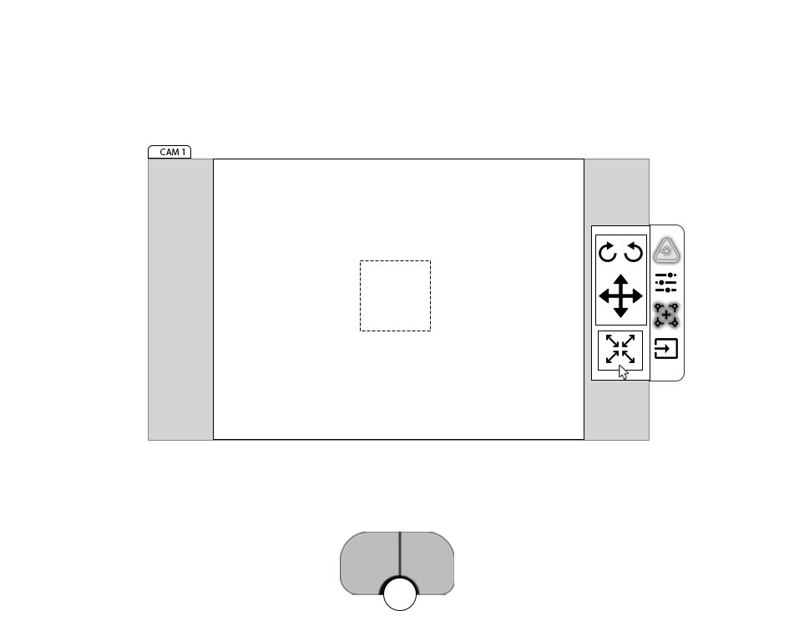

Slide 37
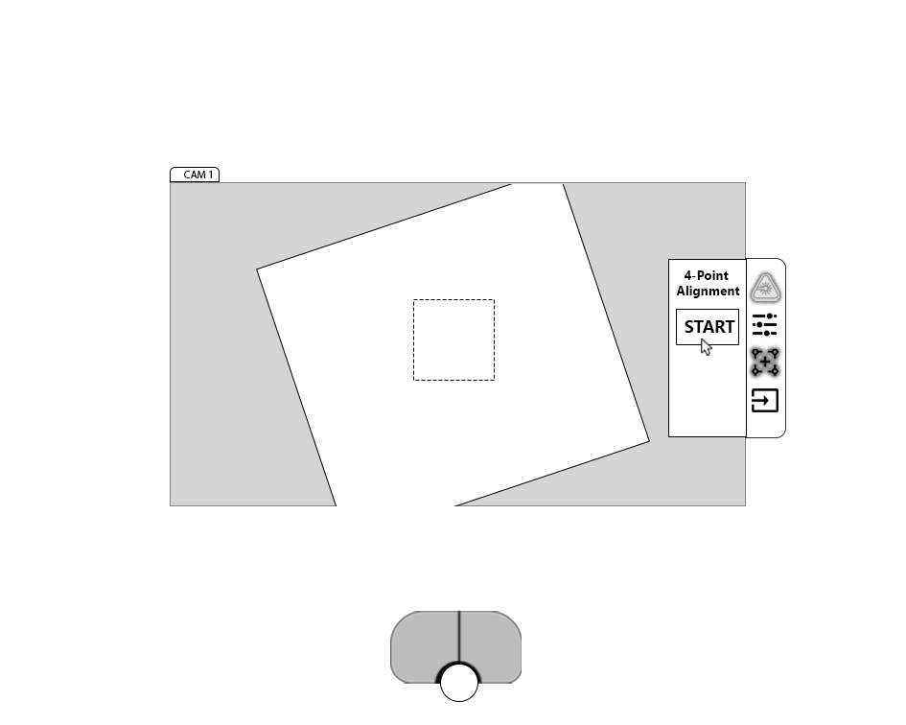

Slide 38
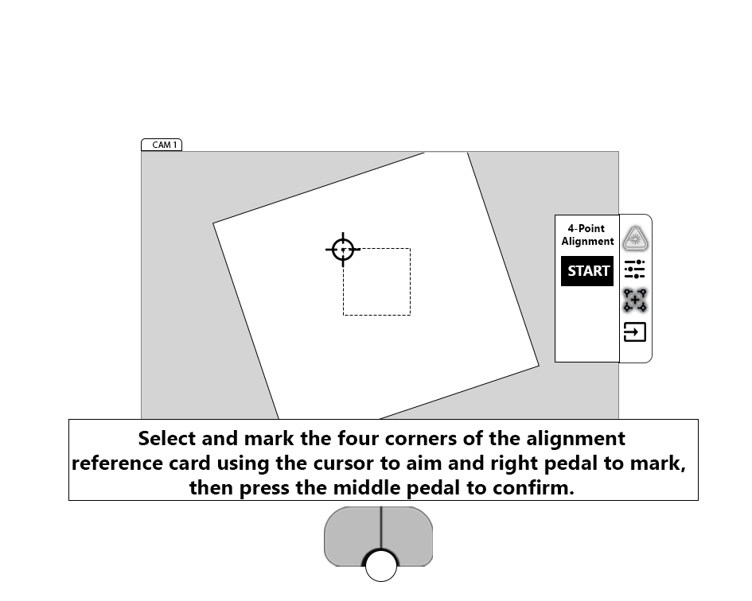

Slide 39
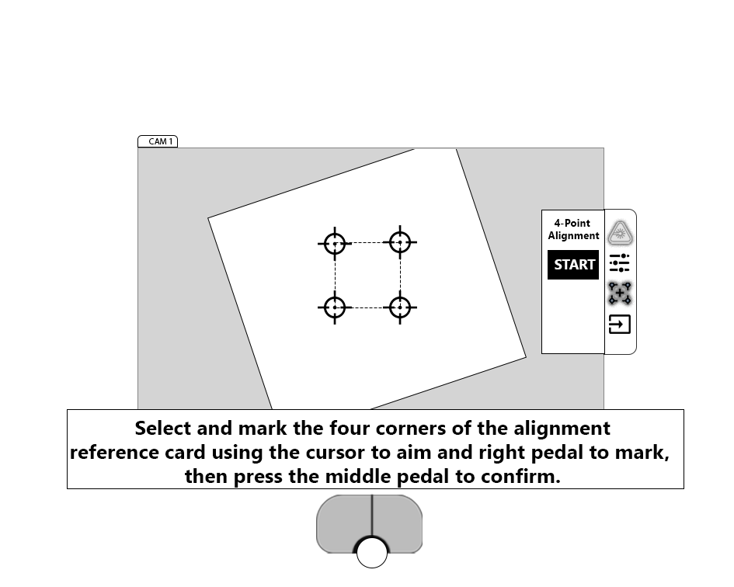

Slide 40
